Slide 1


Test Driven Design
Grange Insurance and Centric Consulting
Presenter: Shawn Wallace
Assisting Pairs: Mike Brooks, Aaron Stonerock

Slide 2
(60 min) First sesstion presentation
Introduction
The Case for TDD
Types of Testing
Example
(120 min) Pairing session. 30-minute sessions executing any of several code katas.
LUNCH BREAK
(60 min) Afternoon session presentation
Design for testability
How to get started on my project
(120 min) Pairing session, Legacy refactor.

Slide 3
Introduction

Slide 4
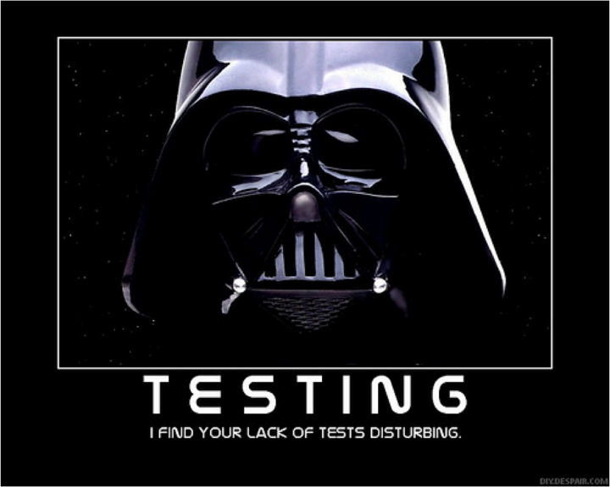

Slide 5
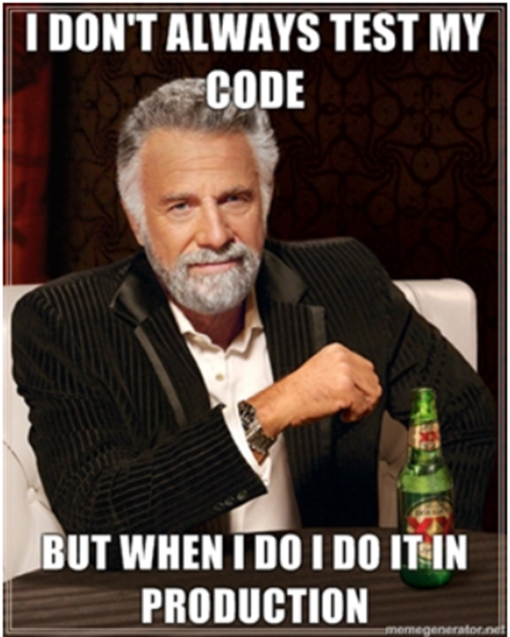

Slide 6
What it is
A Software Development Practice

Slide 7
What it is
Benefits
  Productivity
  Emergent Design
  Better Code
  Reduced Gold-Plating
  Regression Test Suite

Slide 8
What it’s not
A panacea
Done wrong, it’s still wrong

Slide 9
What it’s not
Shortcomings
  Can be difficult
  Management support is crucial
  Self-test paradigm
  Overhead
  Hard to get coverage in legacy systems

Slide 10
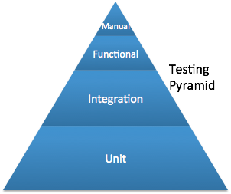
Types of Testing

Slide 11
Studies

Slide 12
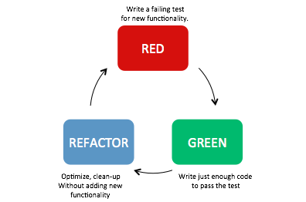
Flow

Slide 13
The Three Rules of TDD
You are not allowed to write any production code unless it is to make a failing unit test pass.
You are not allowed to write any more of a unit test than is sufficient to fail; and compilation failures are failures.
You are not allowed to write any more production code than is sufficient to pass the one failing unit test.
http://butunclebob.com/ArticleS.UncleBob.TheThreeRulesOfTdd

Slide 14
How to Decide
Not really qualified until you do it and are good at it.
It has to work for your project and your team, it might not.

Slide 15

Greenfield Development
a project that lacks any constraints imposed by prior work

Slide 16
How do I start
Notes:
start somewhere

Slide 17
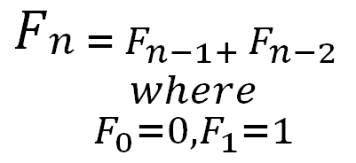
Workflow
Fibonacci Numbers

Slide 18
Red

Slide 19
Green

Slide 20
Refactor

Slide 21
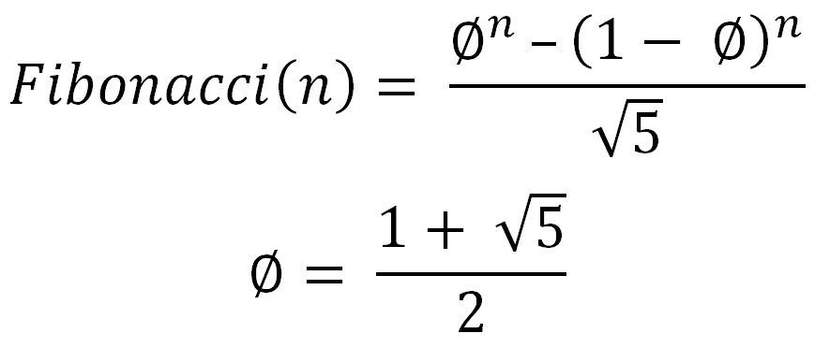
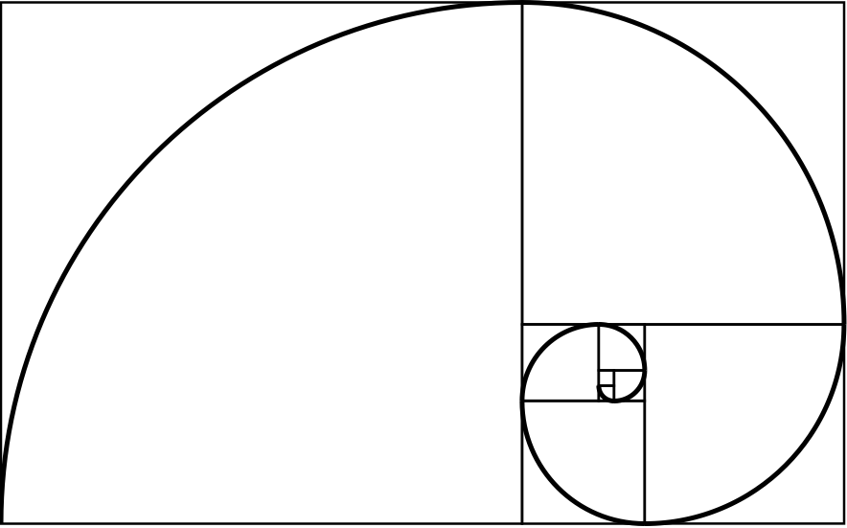
Notes:
Phi - the golden ratio

Slide 22
Work in Pairs

Slide 23
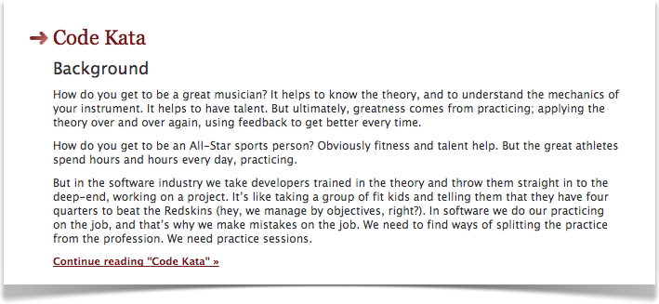
The Code Kata
http://codekata.pragprog.com/

Slide 24
The Code Kata
FizzBuzz
Bowling Game
Leap Year Calculator
Tennis Match
Roman Numeral Converter
One way list

Slide 25
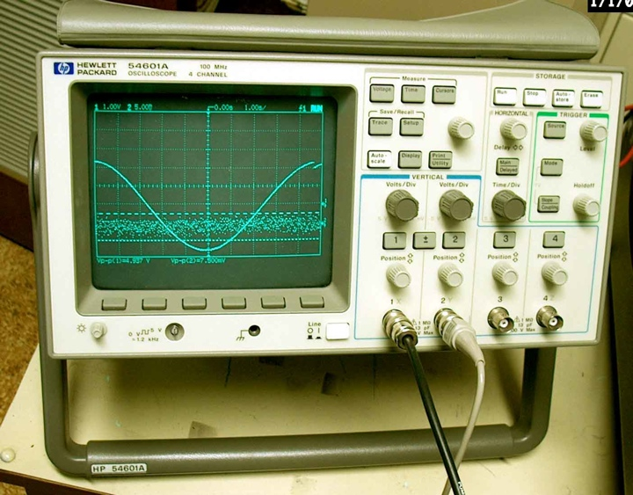
Design for Testability

Slide 26

"Debugging is twice as hard as writing the code in the first place. Therefore, if you write the code as cleverly as possible, you are, by definition, not smart enough to debug it."
--Brian Kernighan
Notes:
Reminds me of a quote
But we have some boundaries

Slide 27
Coupling and Cohesion
Tight vs. Loose Coupling
Interdependency
Coordination
Information Flow
High vs. Low Cohesion
Robustness
Reliability
Reusability
Notes:
cohesion is a measure of how strongly-related or focused the responsibilities of a single module are. As applied to object-oriented programming, if the methods that serve the given class tend to be similar in many aspects, then the class is said to have high cohesion. In a highly-cohesive system, code readability and the likelihood of reuse is increased, while complexity is kept manageable.
Cohesion is decreased if:
The functionalities embedded in a class, accessed through its methods, have little in common.
Methods carry out many varied activities, often using coarsely-grained or unrelated sets of data.
Disadvantages of low cohesion (or “weak cohesion”) are:
Increased difficulty in understanding modules.
Increased difficulty in maintaining a system, because logical changes in the domain affect multiple modules, and because changes in one module require changes in related modules.
Increased difficulty in reusing a module because most applications won’t need the random set of operations provided by a module.

Slide 28
Coupling and Cohesion
We want LOOSE COUPLING
and
HIGH COHESION

Slide 29
Object Oriented Principles

Slide 30
Object Oriented Principles
Single Responsibility Principle
Open/closed Principle
Liskov Substitution Principle
Interface Segregation Principle
Dependency Inversion Principle
Notes:
SRP
Single responsibility principle
the notion that an object should have only a single responsibility.
OCP
Open/closed principle
the notion that “software entities … should be open for extension, but closed for modification”.
LSP
Liskov substitution principle
the notion that “objects in a program should be replaceable with instances of their subtypes without altering the correctness of that program”. See also design by contract.
ISP
Interface segregation principle
the notion that “many client specific interfaces are better than one general purpose interface.”[5]
DIP
Dependency inversion principle
the notion that one should “Depend upon Abstractions. Do not depend upon concretions.”[5]
Dependency injection is one method of following this principle.

Slide 31
Code to interfaces, depending on your languages

Slide 32

Brownfield Development

Slide 33
Can we benefit?
Can improve design going forward
The goal is writing working code/providing value

Slide 34
How to start
Test KEY use cases
Test defects
Test new features

Slide 35
Refactor
Discover the intent
Isolate Dependencies (Inversion of Control)
Re-design for testability
Address anti-patterns

Slide 36
Refactor
Key anti-patterns
  Magic Numbers
  Long Methods
  Long Class
  Poor Naming
  Empty Catches
  Similar Code
  Unclear Tests
  Large Tests

Slide 37

Shawn Wallace
shawn.wallace@centricconsulting.com
http://about.me/shawnwallace
@ShawnWallace
614-270-1600

